Slide 1


Buildings no longer
just operate;
they think with you.
KATRE S-BAS • Smart Building Automation Platform
Sales and solution presentation
KATRE S-BAS
01
Notes:
[Sources]
- KATRE S-BAS proje dosyaları ve uygulama ekran görüntüleri (kurum içi kaynak).
[/Sources]

Slide 2
Fragmented systems make management harder
Users expect fewer apps, clearer control and more secure access.
Fragmented control
Unclear status
Lighting, climate, curtains, outlets and sensors managed through different methods.
No single view of whether a device is on, online or at the correct value.
Difficult sharing
Manual operation
Controlled access for family, employees or facility staff becomes complex.
Repeated daily tasks remain dependent on user intervention.
KATRE S-BAS
02
Notes:
[Sources]
- KATRE S-BAS proje dosyaları ve uygulama ekran görüntüleri (kurum içi kaynak).
[/Sources]

Slide 3
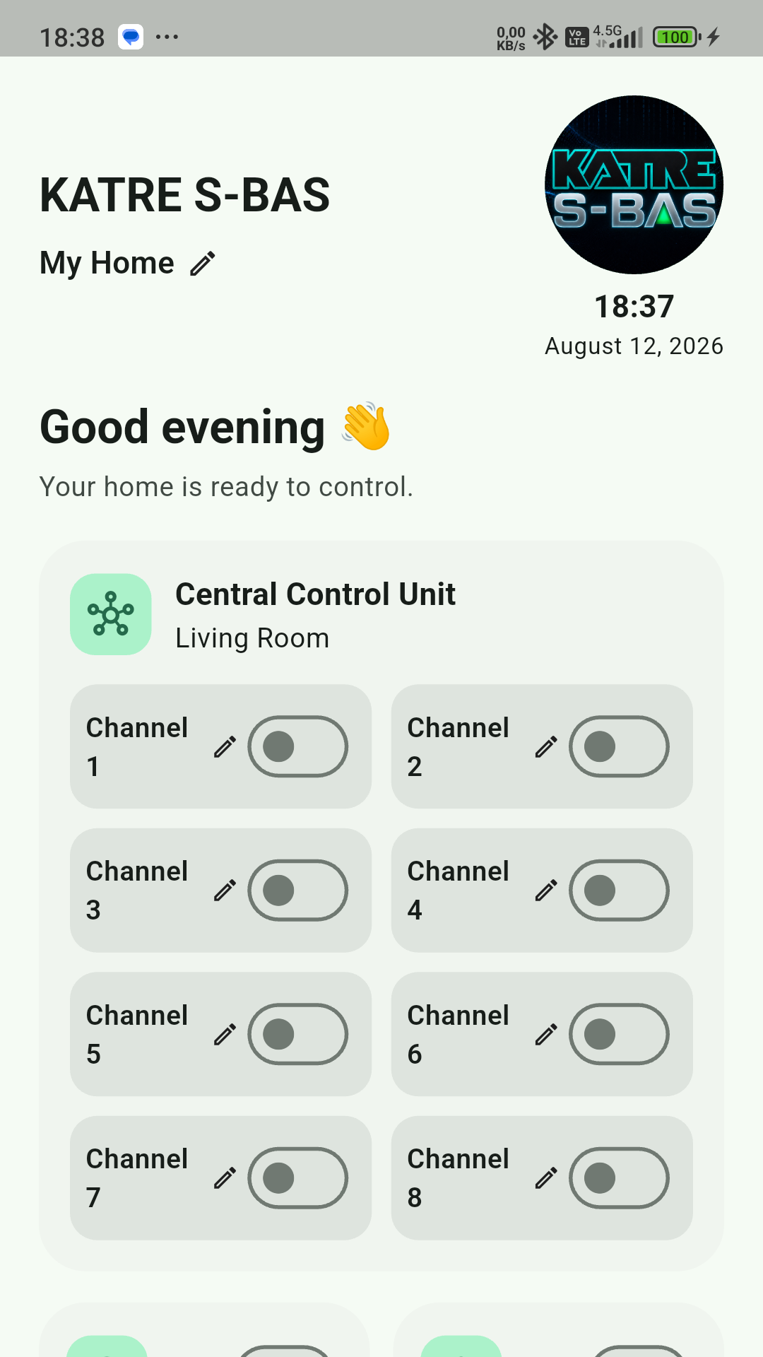
One app, one integrated building experience
KATRE S-BAS brings devices, users and automation rules together on a shared platform.
Control from one place
Monitor room and device status in real time and directly manage supported devices.
A personal experience
Language, region and theme options adapt the interface to each user.
Automation and scenarios
Define device behavior by time, day of the week or sensor conditions.
Secure sharing
Controlled use with detailed permissions defined by the device owner.
KATRE S-BAS
03
Notes:
[Sources]
- KATRE S-BAS proje dosyaları ve uygulama ekran görüntüleri (kurum içi kaynak).
[/Sources]

Slide 4
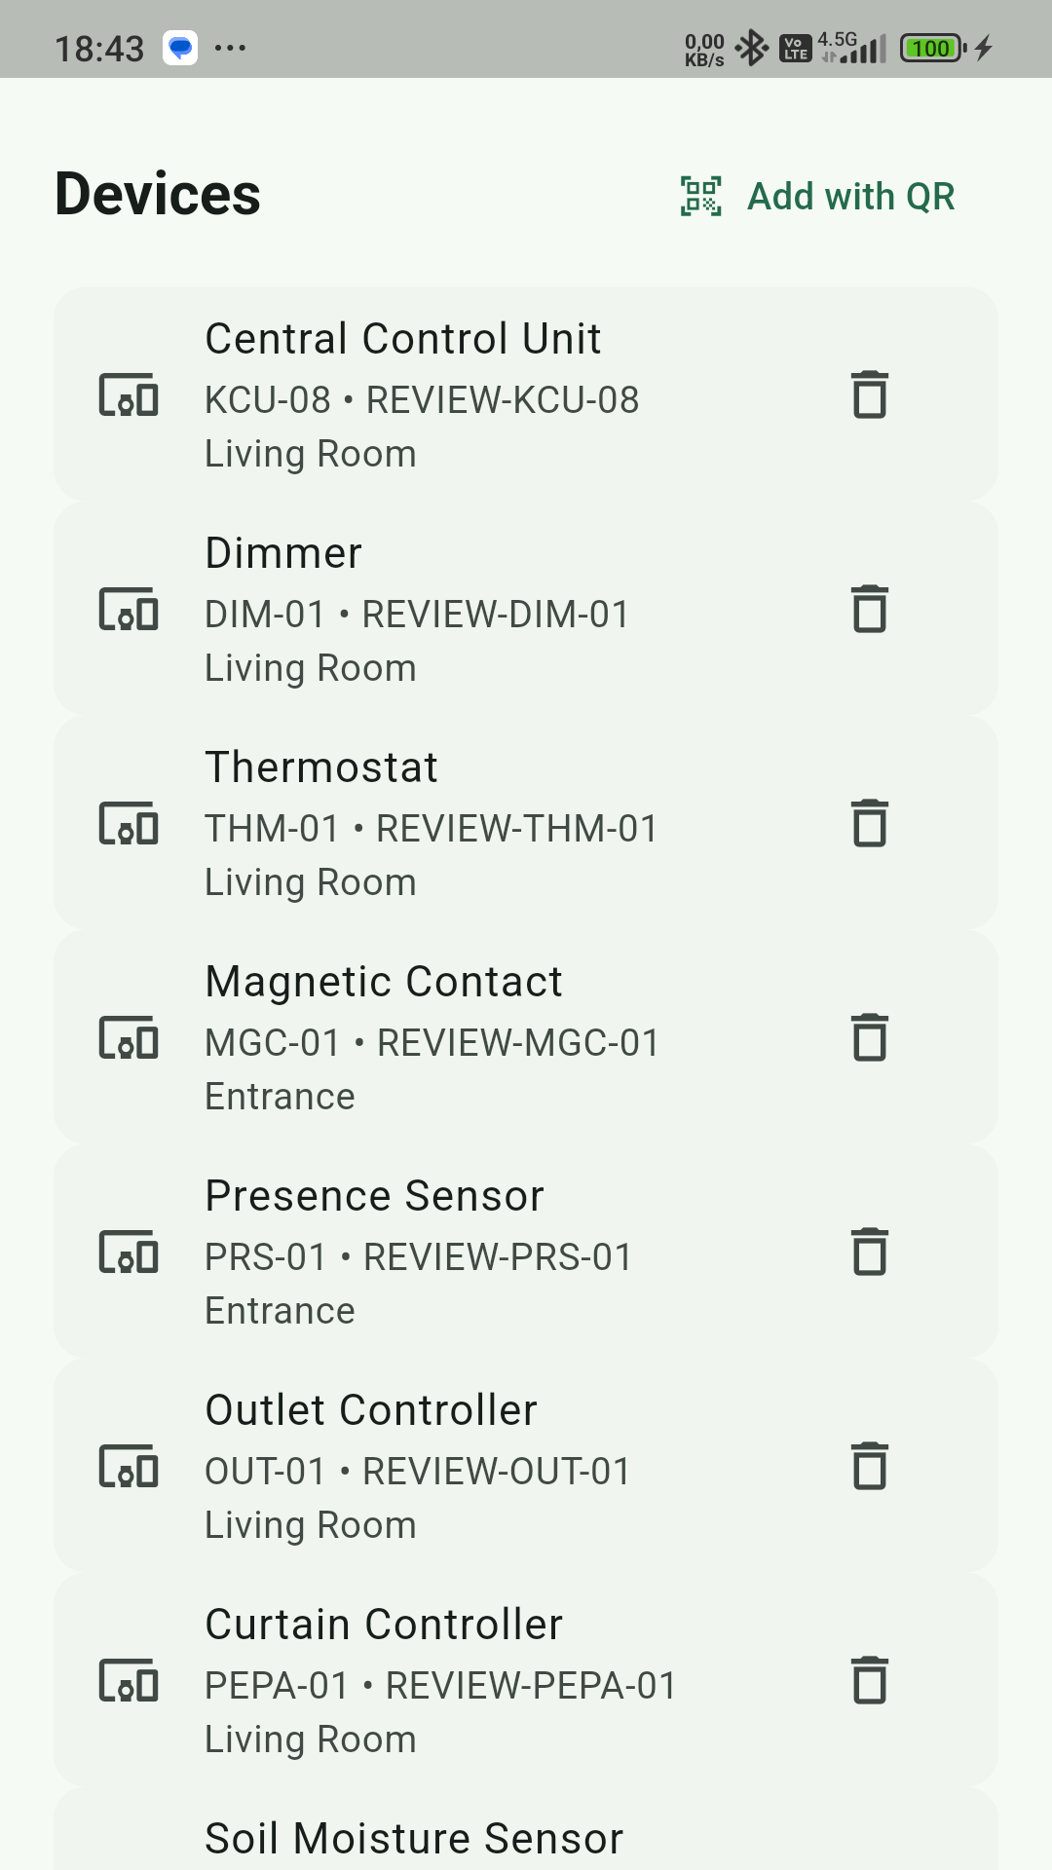
Simple setup, controlled device verification
Scan the QR code, verify the product, select the room and start using it.
01
Scan the QR code
The application reads the serial number.
02
Verify inventory
The product and serial number are checked on the server.
03
Assign a room
The user selects the room where the device belongs.
04
Start controlling
The correct controls appear automatically for the device type.
KATRE S-BAS
04
Notes:
[Sources]
- KATRE S-BAS proje dosyaları ve uygulama ekran görüntüleri (kurum içi kaynak).
[/Sources]

Slide 5
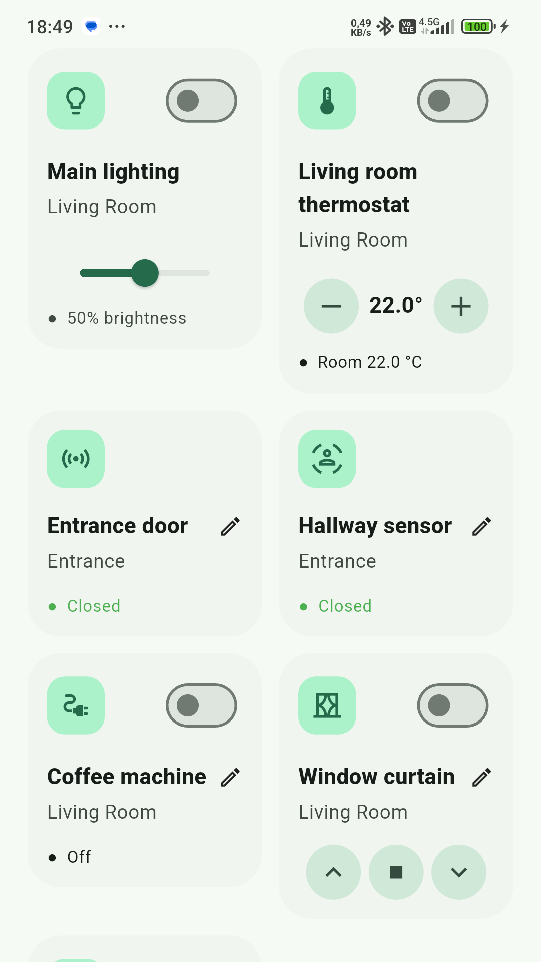
Purpose-built controls for every device
Users see only the controls they need while technical complexity stays in the background.
Dimmer
Curtain / shutter
Power and brightness
Up, down and stop
Control unit
Outlet and output
Multiple channels by model
One-touch control
Thermostat
Sensors
Target and room temperature
Contact, presence and moisture status
KATRE S-BAS
05
Notes:
[Sources]
- KATRE S-BAS proje dosyaları ve uygulama ekran görüntüleri (kurum içi kaynak).
[/Sources]

Slide 6
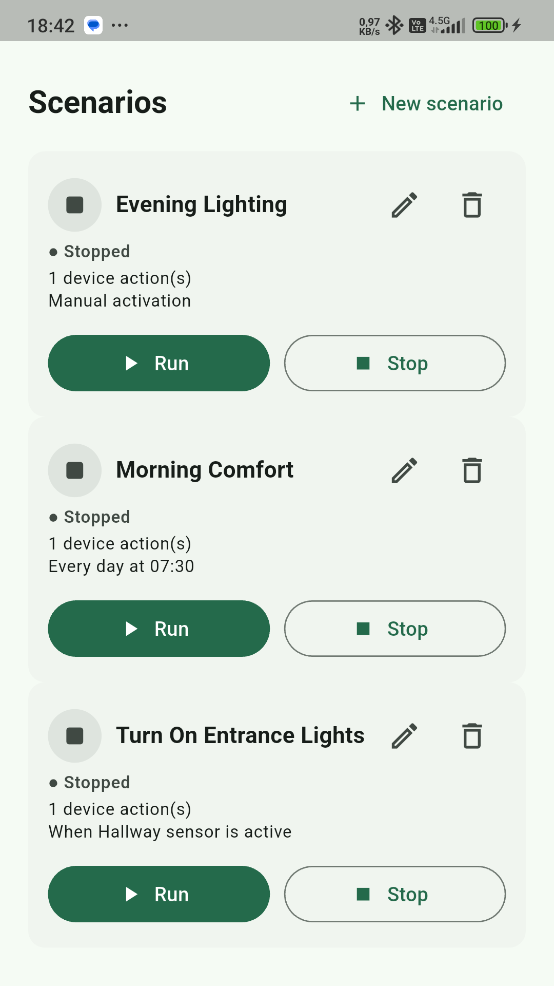
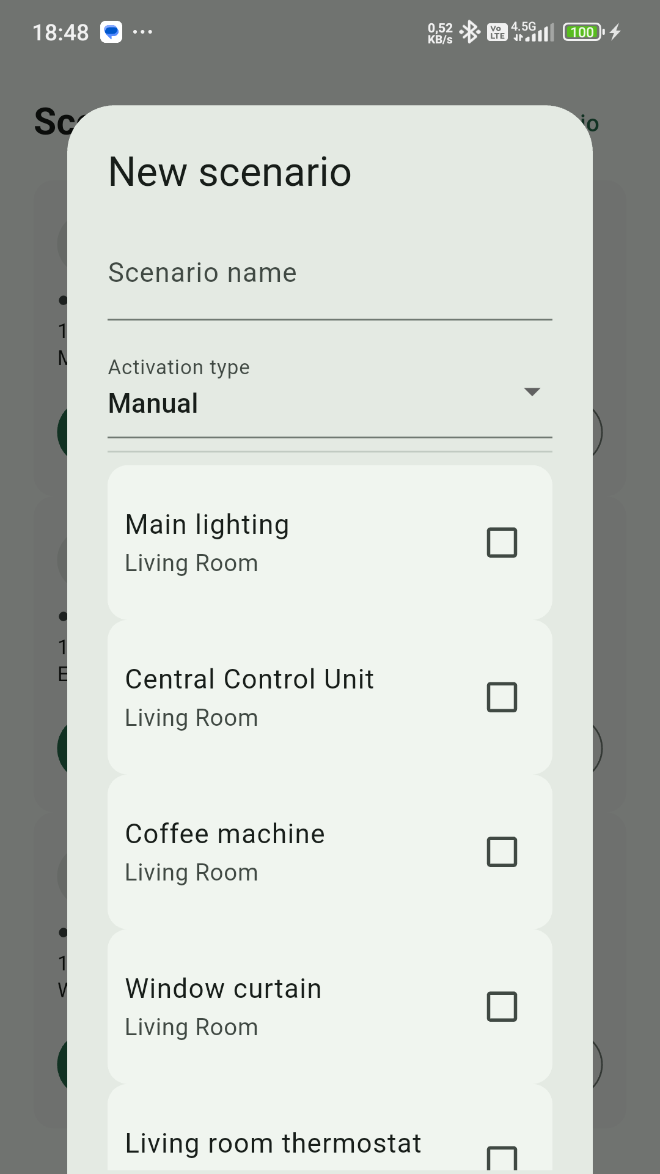
Turn routines into scenarios
Time and device status work together to deliver consistent automation.
Example use
Evening comfort
Set lighting, curtains and temperature on selected days.
Sensor response
Automatically activate authorized devices when presence or contact status changes.
You stay in control
Start, stop, edit or remove a scenario whenever needed.
KATRE S-BAS
06
Notes:
[Sources]
- KATRE S-BAS proje dosyaları ve uygulama ekran görüntüleri (kurum içi kaynak).
[/Sources]

Slide 7
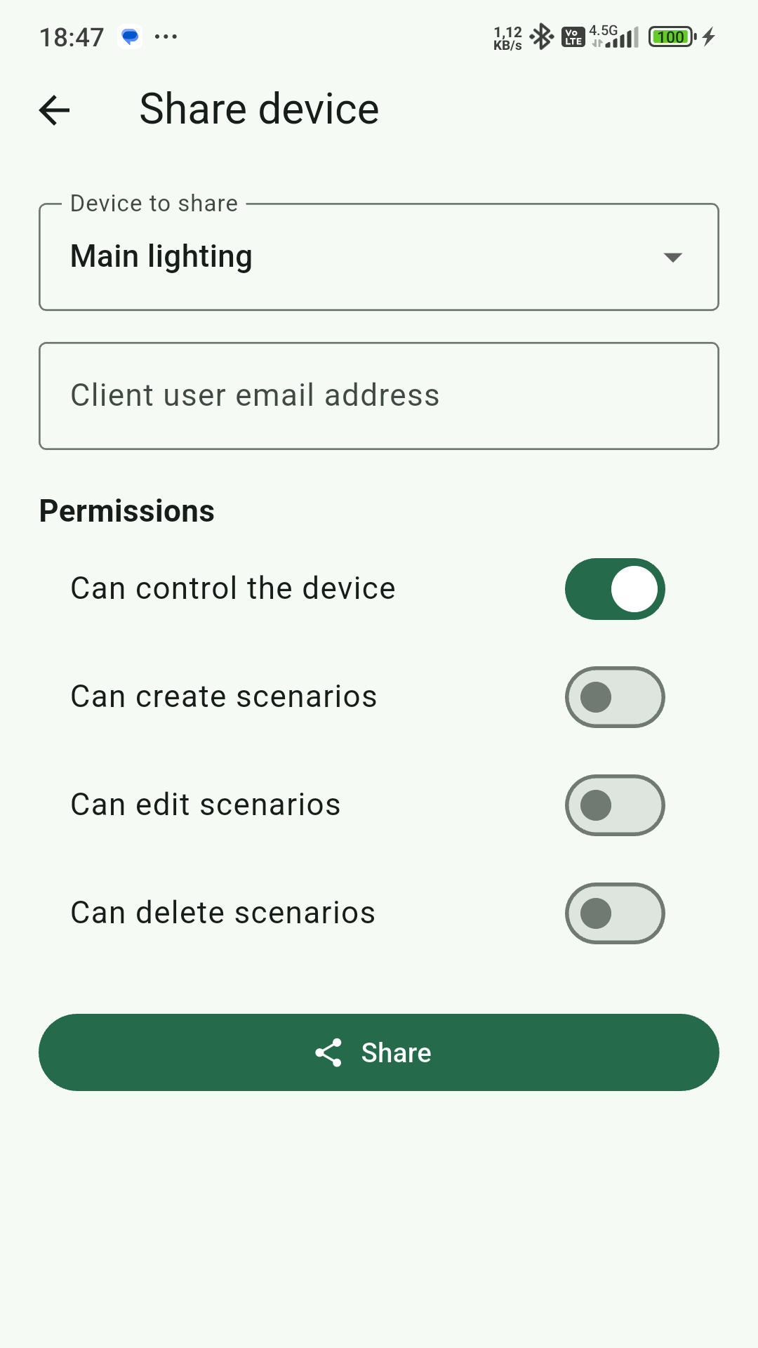
Sharing means managing permissions, not simply granting access
The device owner remains the master and defines permissions separately for every client.
✓
View devices
✓
Control devices
✓
Create scenarios
✓
Edit scenarios
✓
Delete scenarios
Registered user verification
KATRE S-BAS
07
Notes:
[Sources]
- KATRE S-BAS proje dosyaları ve uygulama ekran görüntüleri (kurum içi kaynak).
[/Sources]

Slide 8
Security is applied at every layer of the platform
Identity, authorization, communication and data security work together without complicating the user experience.
Identity
Session
Authorization
Email verification, strong password practices and CAPTCHA
Secure session management and credential termination at logout
Server-side validation of ownership and sharing permissions
Communication
Access
Audit
Encrypted web traffic and TLS-enabled device communication
The administration area is protected with separate, additional access controls.
Rate limiting and security logs for sensitive operations
KATRE S-BAS
08
Notes:
[Sources]
- KATRE S-BAS proje dosyaları ve uygulama ekran görüntüleri (kurum içi kaynak).
[/Sources]

Slide 9
The management panel makes the product lifecycle visible
Authorized teams manage user, product, device and sharing records from one center.
Product inventory
QR code generation
Model, product name, serial number and date information
Printable QR codes for inventory devices
User management
Sharing visibility
Controlled viewing and management of records
See who a device was shared with and when
KATRE S-BAS
09
Notes:
[Sources]
- KATRE S-BAS proje dosyaları ve uygulama ekran görüntüleri (kurum içi kaynak).
[/Sources]

Slide 10
KATRE S-BAS brings one operating model to different building types
Scale and device diversity may change; the user experience and authorization model remain consistent.
01
02
03
04
Homes and residences
Offices and commercial spaces
Hotels and tourism facilities
Small facilities and sites
Unify comfort, energy and security controls in one app.
Manage common areas, climate and lighting through scenarios.
Standardize the room experience and simplify operational control.
Monitor sensor status and enable authorized remote intervention.
One platform • controlled access • scenario automation • scalable device architecture
KATRE S-BAS
10
Notes:
[Sources]
- KATRE S-BAS proje dosyaları ve uygulama ekran görüntüleri (kurum içi kaynak).
[/Sources]

Slide 11
Customer value goes beyond technology
KATRE S-BAS simplifies daily use while giving operators control and visibility.
A simpler experience
One interface with controls designed for each device type
Less repetition
Time- and condition-based scenarios
More controlled sharing
Detailed permissions by person and operation
A stronger brand relationship
A consistent digital experience across the KATRE ecosystem
A digital platform that extends the smart building experience beyond installation
KATRE S-BAS
11
Notes:
[Sources]
- KATRE S-BAS proje dosyaları ve uygulama ekran görüntüleri (kurum içi kaynak).
[/Sources]

Slide 12
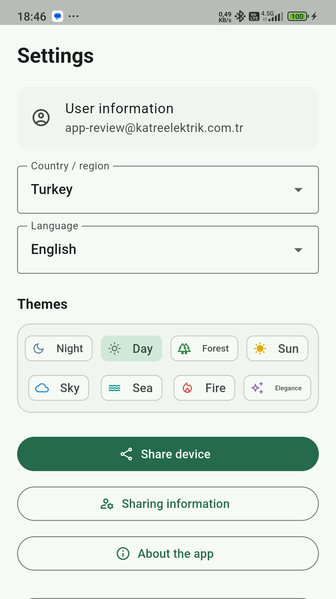
The app is the continuous touchpoint of the brand experience
Themes, languages, device names and a customizable home screen support user engagement.
Personalization
Eight theme options
Turkish and English interfaces
Editable device and channel names
Room- and location-based views
Outcome
Turns a technical system into a clear, branded user experience.
KATRE S-BAS
12
Notes:
[Sources]
- KATRE S-BAS proje dosyaları ve uygulama ekran görüntüleri (kurum içi kaynak).
[/Sources]

Slide 13
Let’s make the next building
smarter together.
Needs analysis → device plan → pilot installation → commissioning
KATRE Elektrik Elektronik Engineering Construction Tourism Industry and Trade Ltd. Co.
s-bas@katreelektrik.com.tr
KATRE S-BAS
13
Notes:
[Sources]
- KATRE S-BAS proje dosyaları ve uygulama ekran görüntüleri (kurum içi kaynak).
[/Sources]

